Slide 1
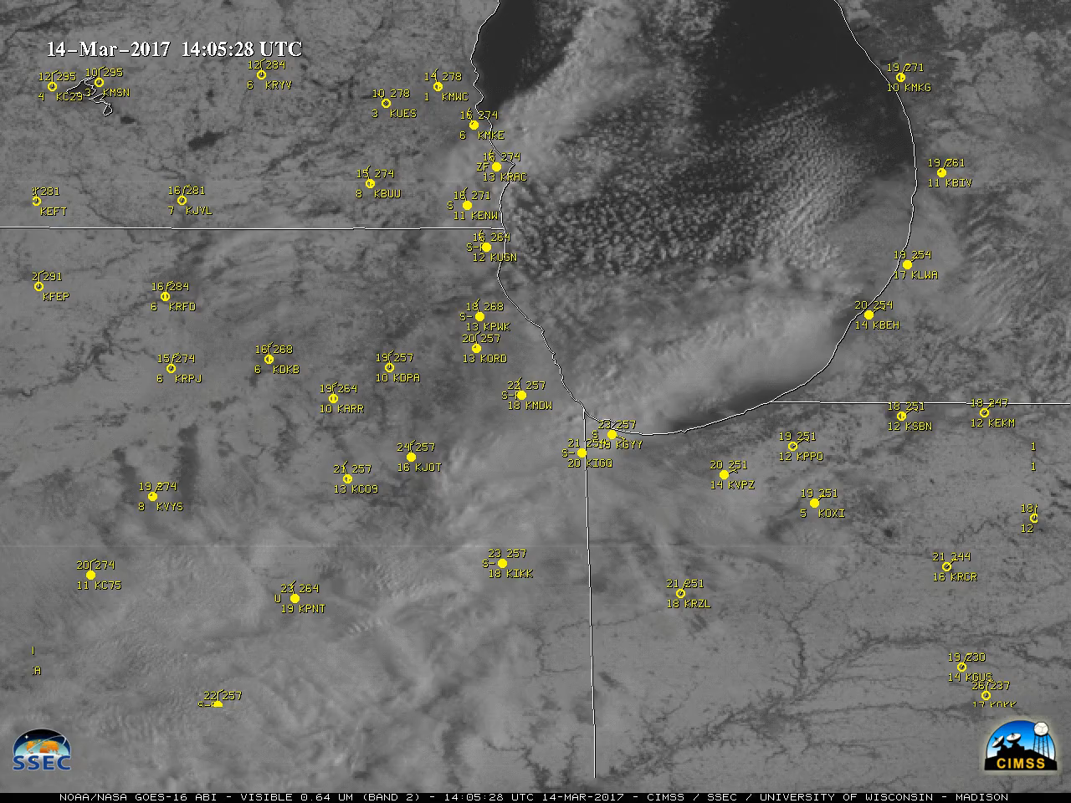
Lake Effect Snow
Movie courtesy UW-Madison/CIMSS

Slide 2
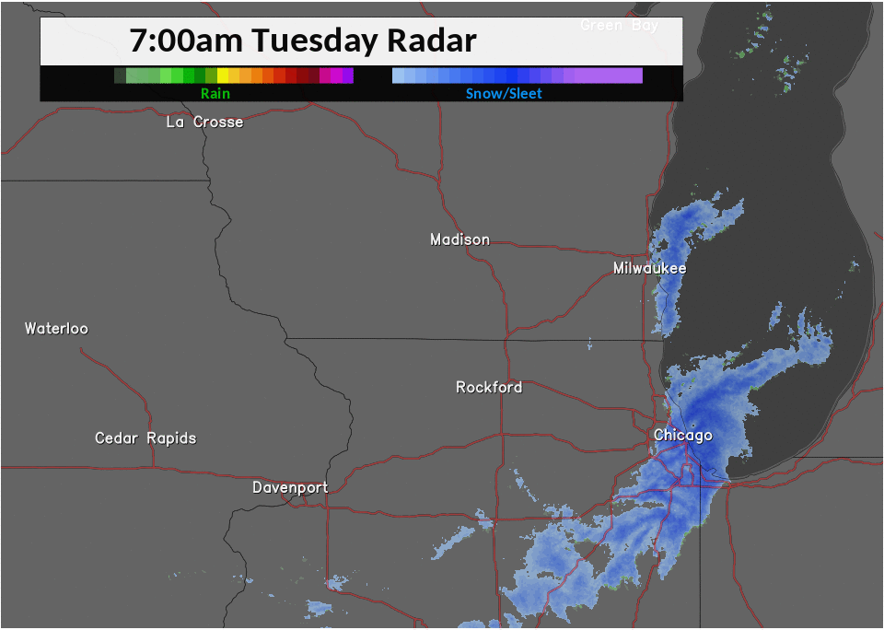
Lake Effect Snow
Radar loop courtesy NWS/Milwaukee-Sullivan, WI

Slide 3
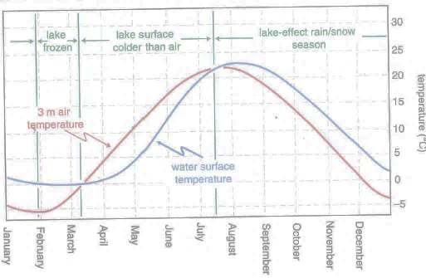
Lake Effect Precipitation Climatology
Figure from Markowski and Richardson (2010), their Fig. 4.19.

Slide 4
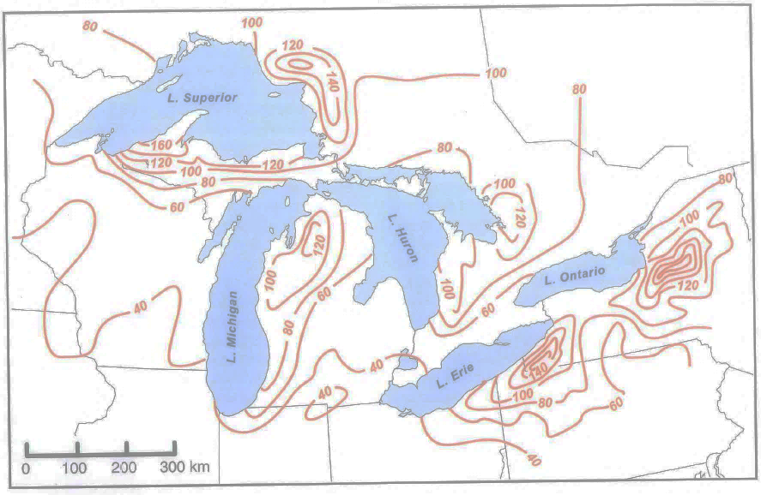
Lake Effect Snow Climatology
Figure from Markowski and Richardson (2010), their Fig. 4.17.

Slide 5
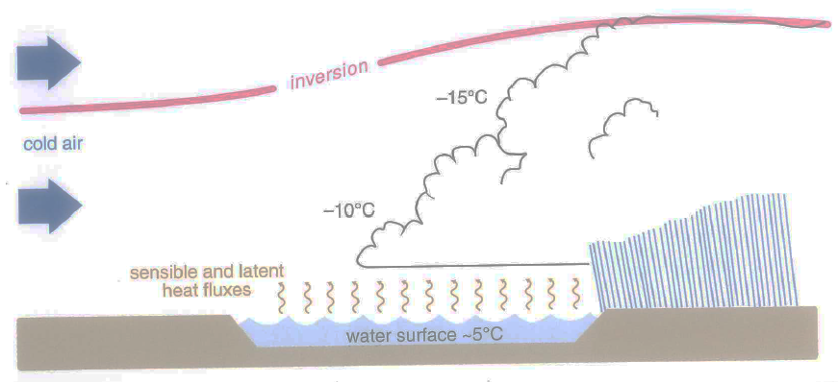
Conceptual Schematic
Figure from Markowski and Richardson (2010), their Fig. 4.20.

Slide 6
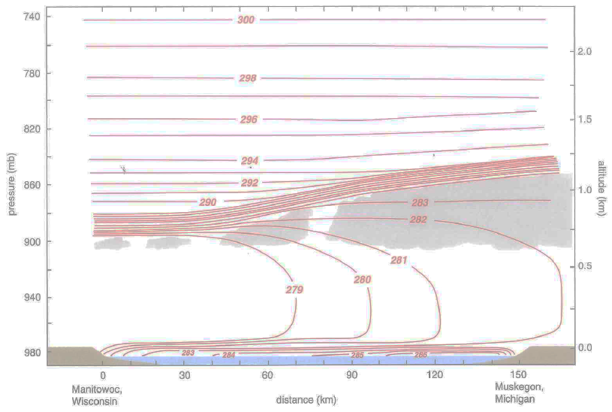
Conceptual Schematic: Potential Temperature
Figure from Markowski and Richardson (2010), their Fig. 4.21.

Slide 7
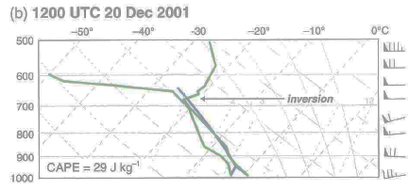
Representative Sounding Structure
Figure from Markowski and Richardson (2010), their Fig. 4.22b.

Slide 8
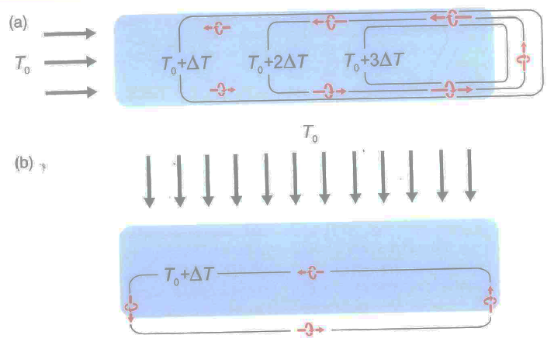
Importance of Fetch
Figure from Markowski and Richardson (2010), their Fig. 4.23.

Slide 9
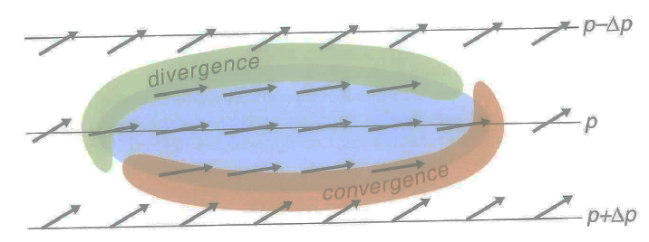
Importance of Friction
Figure from Markowski and Richardson (2010), their Fig. 4.24.

Slide 10
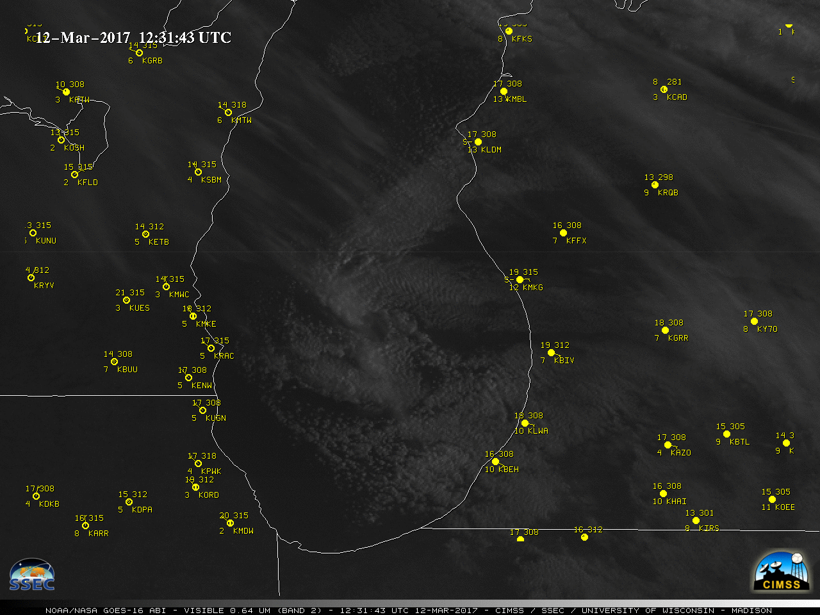
Mesovortices
Note the generally light synoptic-scale winds, common to mesolow events.
Movie courtesy UW-Madison/CIMSS

